Slide 1
Smart locker
Jarno Cools
Oussama Es-Salhi
Imad El-Azzouzi
Afaq Mughal

Slide 2

Afgewerkte user stories
Subtasks

Slide 3
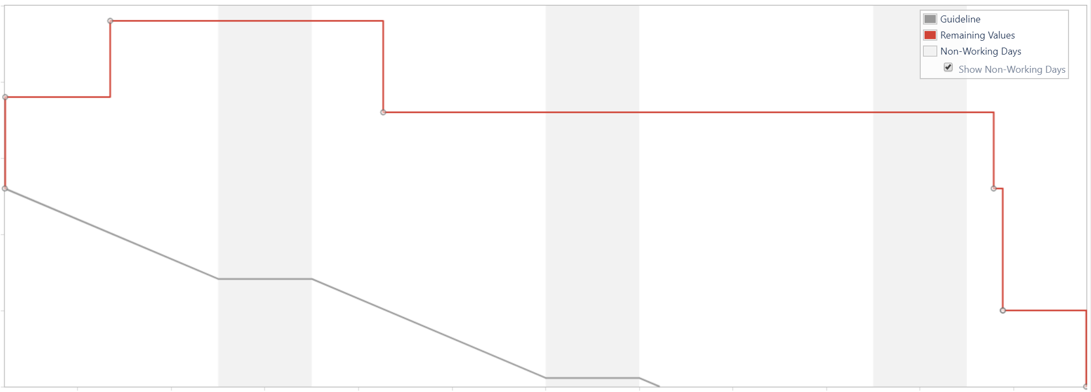
Burndown chart

Slide 4
Openstaande problemen
Security
Integratie : alle componenten met elkaar verbinden (tussen software en hardware)

Slide 5
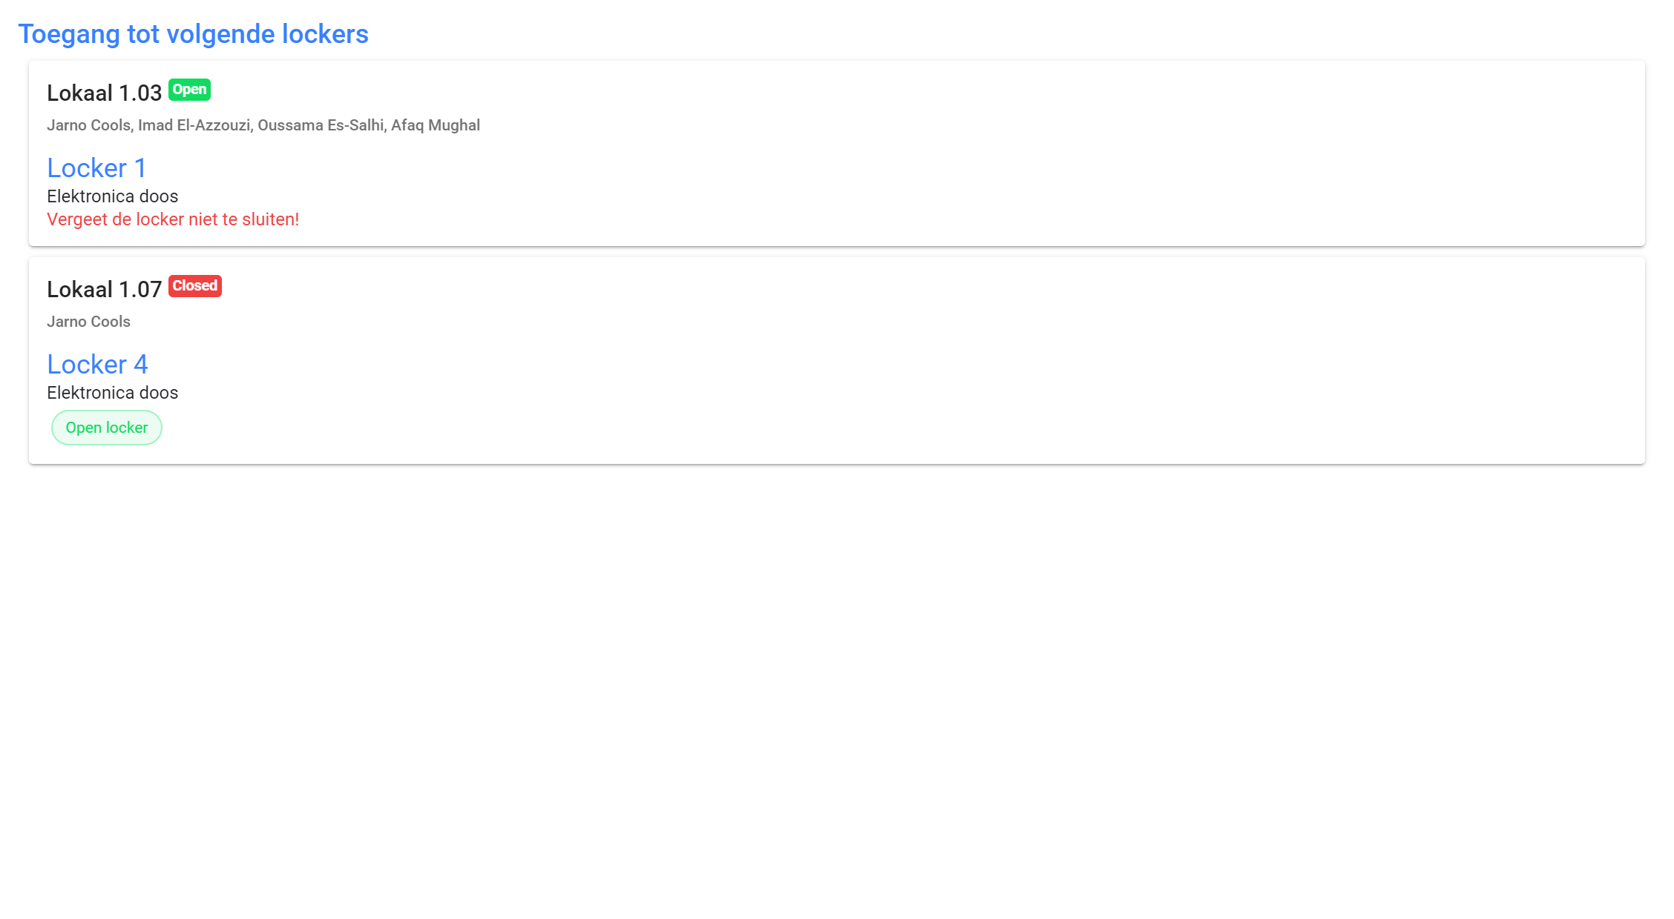
Jarno Cools - Project Manager
Studentenkaart scanner
Webinterface lockers

Slide 6
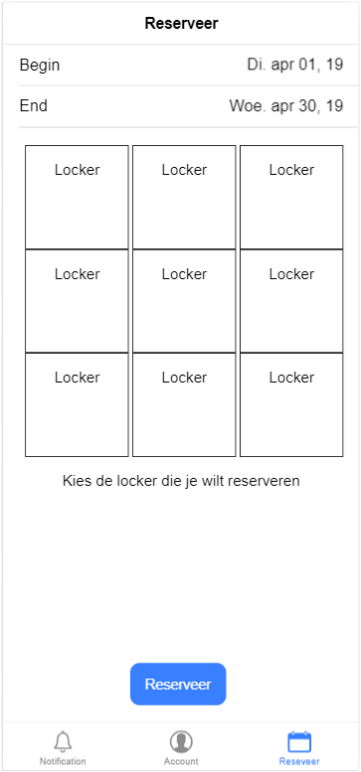
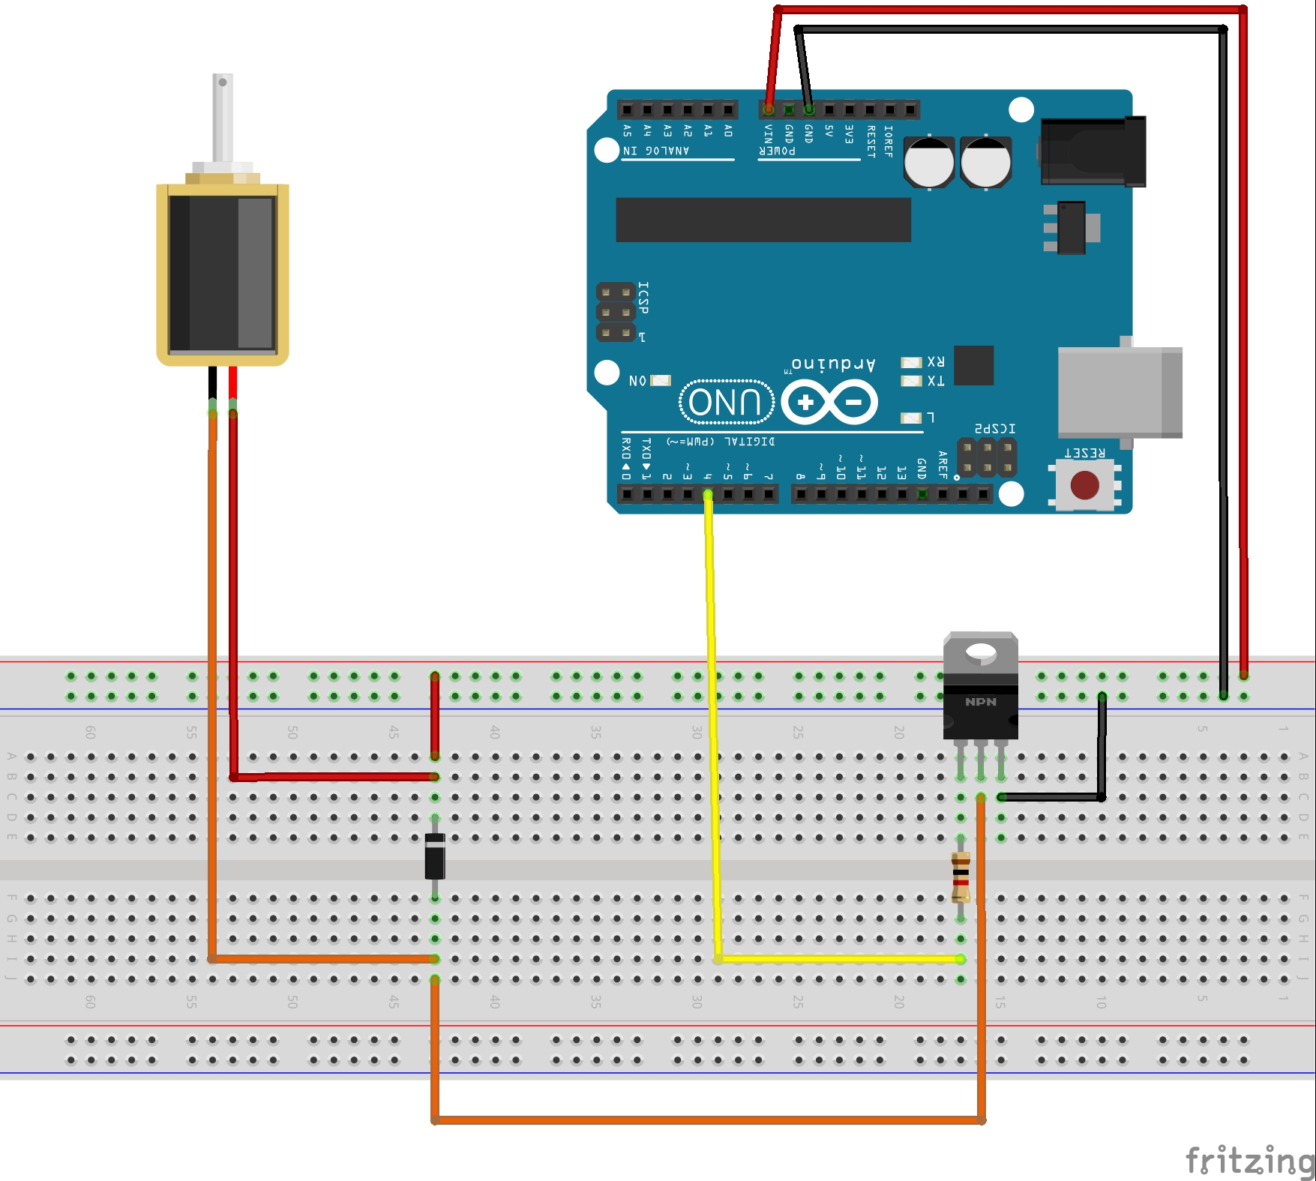
Imad El-Azzouzi - Applicatie Smartphone
Solenoid, first testing App progress:

Slide 7



Oussama Es-Salhi - Back-end
Rest Api
Socket.io server
Socket.io client
RPIO

Slide 8
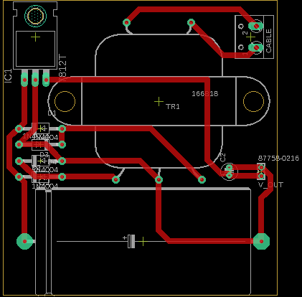
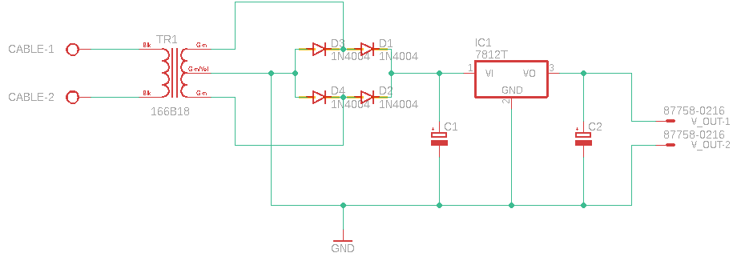
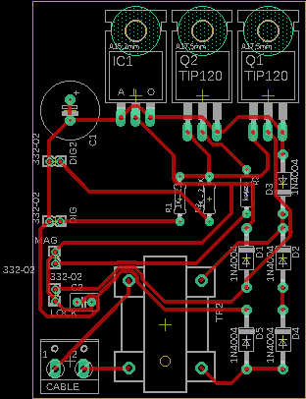
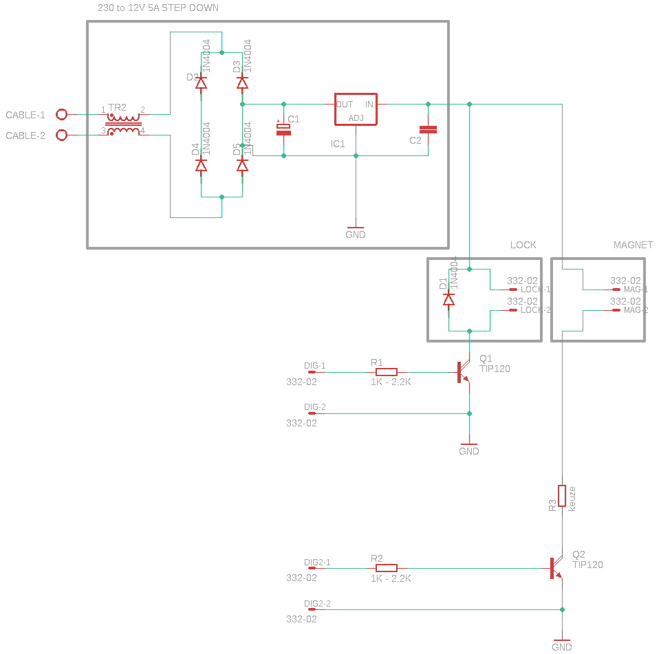
Afaq Mughal - Hardware
Notes:
Transfo
Diodebrug
Condensators
Voltage regulator
OUTPUT

